Slide 1
Staircase Traversal
2023/03/19

Slide 2
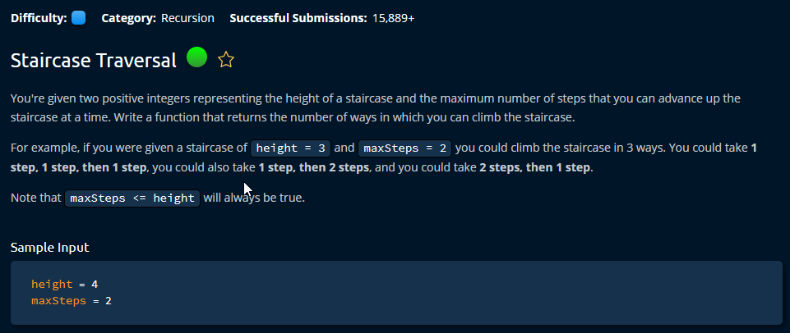

Slide 3
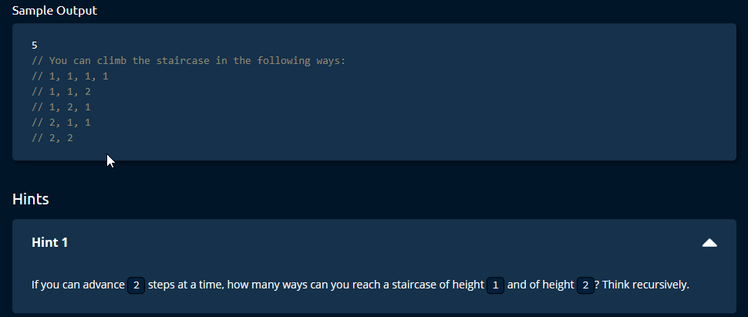

Slide 4
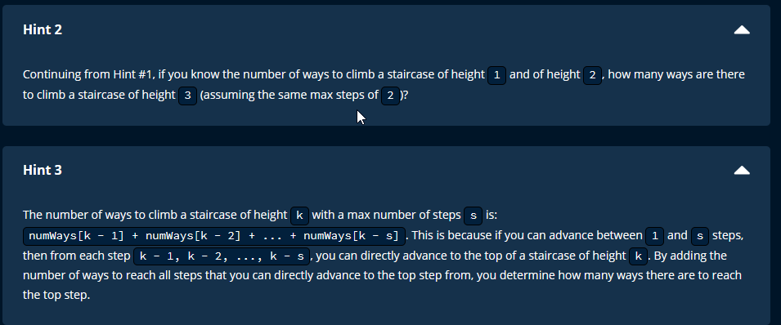

Slide 6
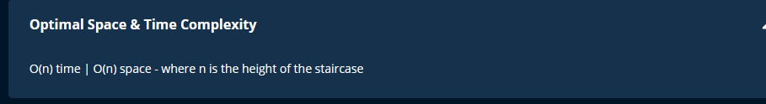

Slide 7
Solution 1
time = O(k^n), space O(n)

Slide 8
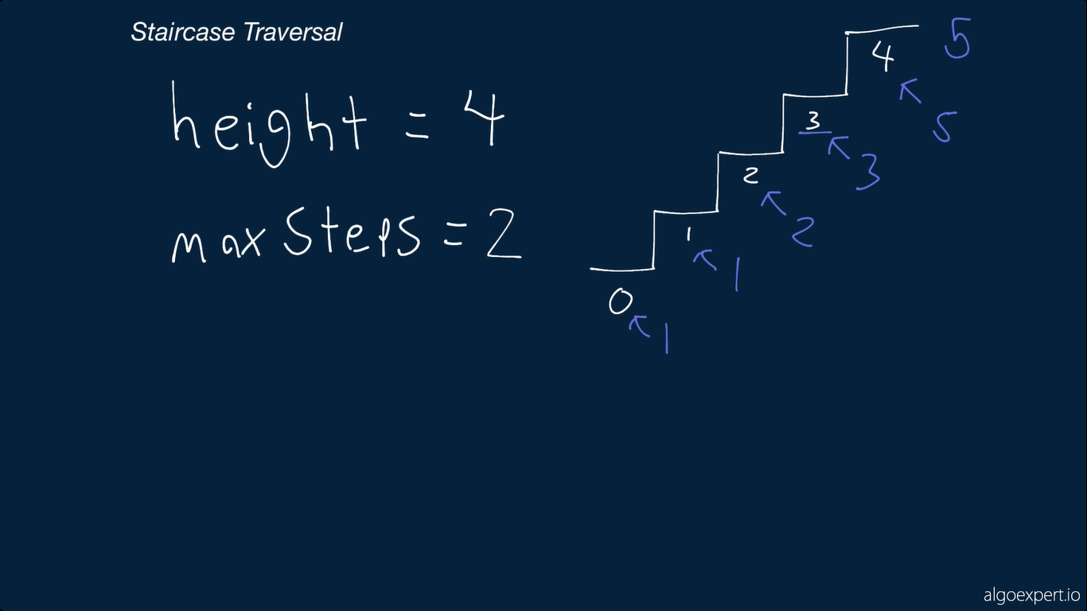

Slide 9
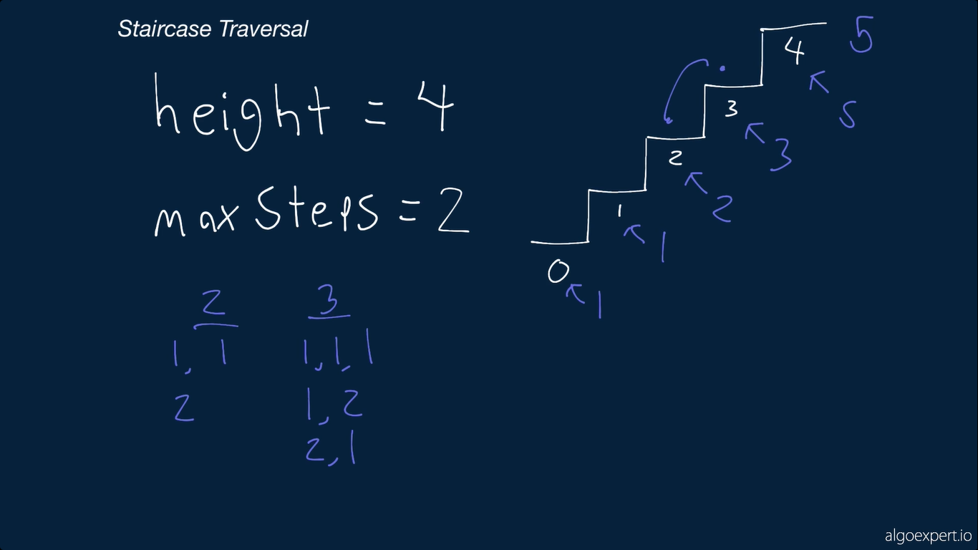

Slide 10
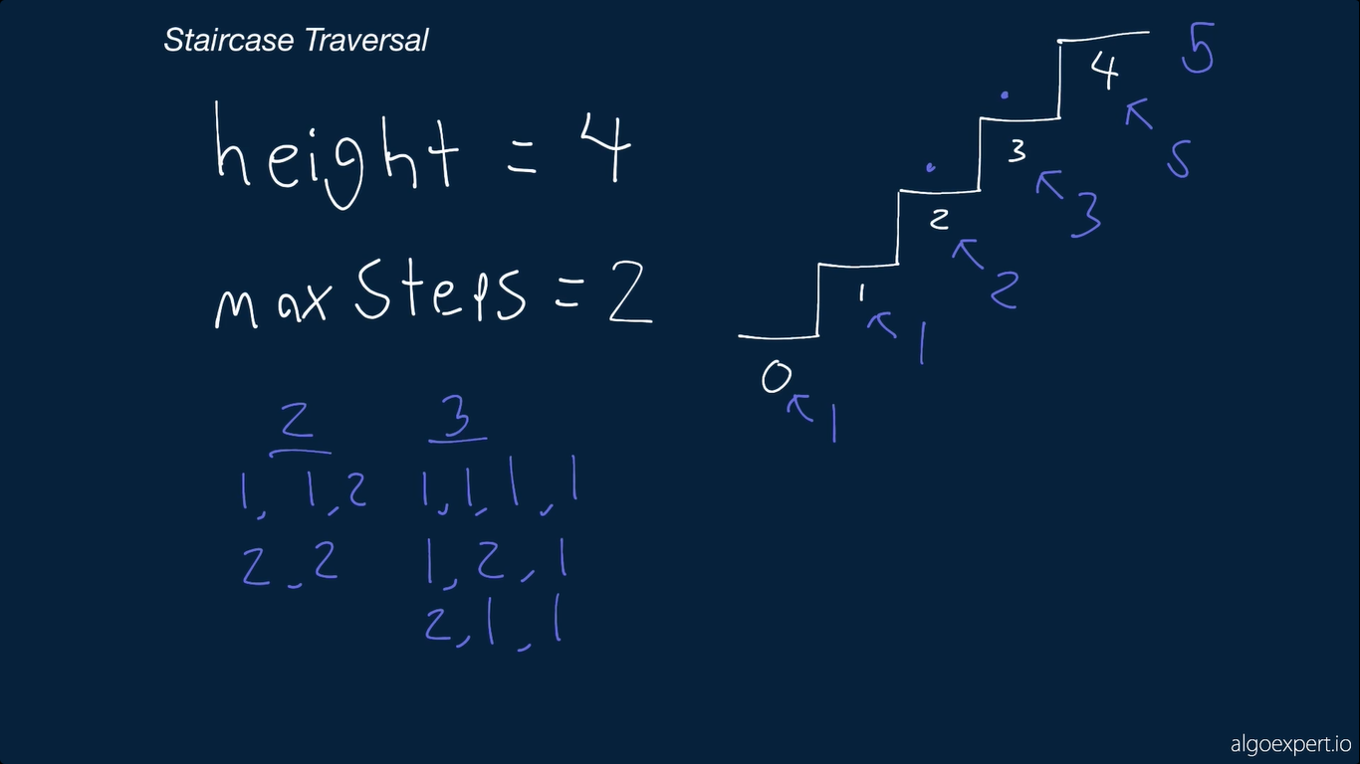

Slide 11
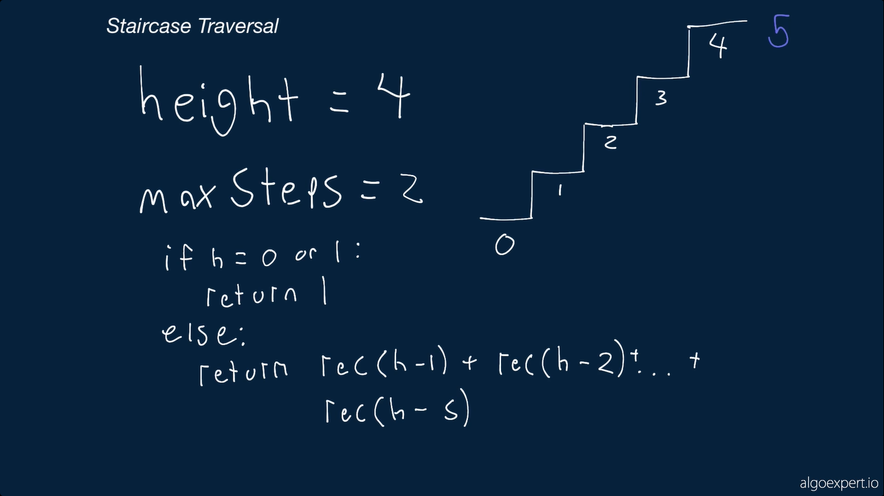

Slide 12
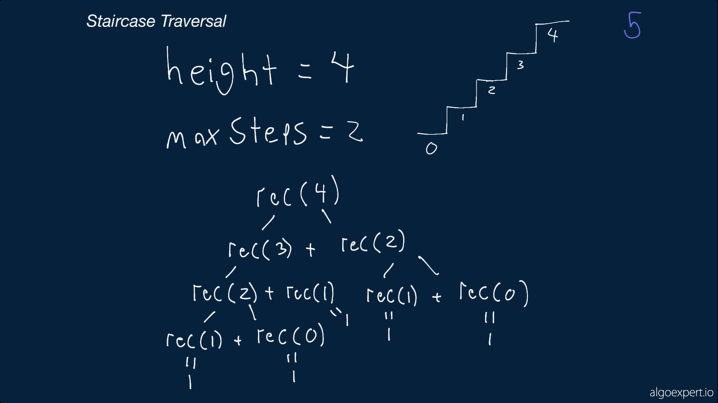

Slide 13
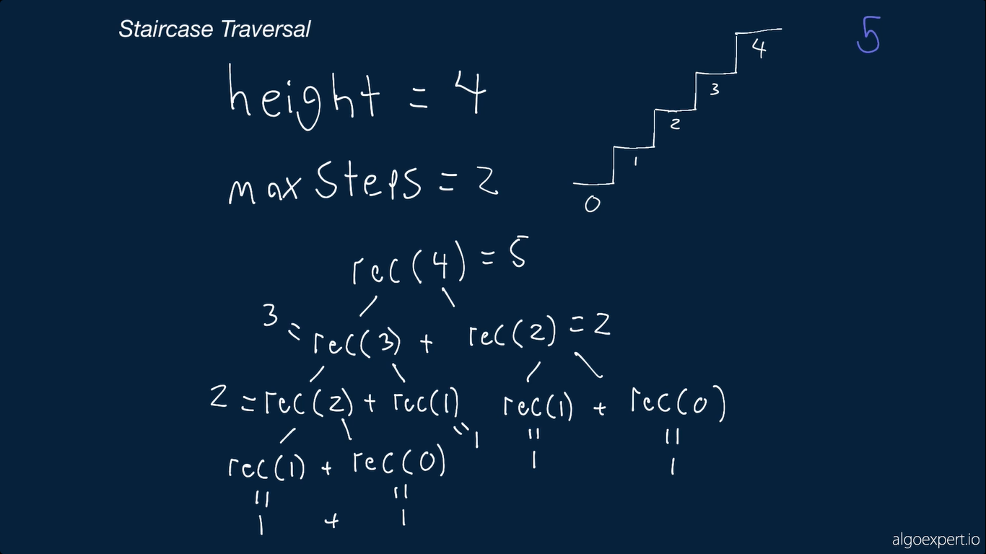

Slide 14
Solution 2
# time = O(k*n), space O(n)

Slide 15
# time = O(k*n), space O(n)
Time complexity
Eradicate all the duplicate calls done in solution 1.
Space complexity
Build a dictionary to store the used calls.

Slide 16
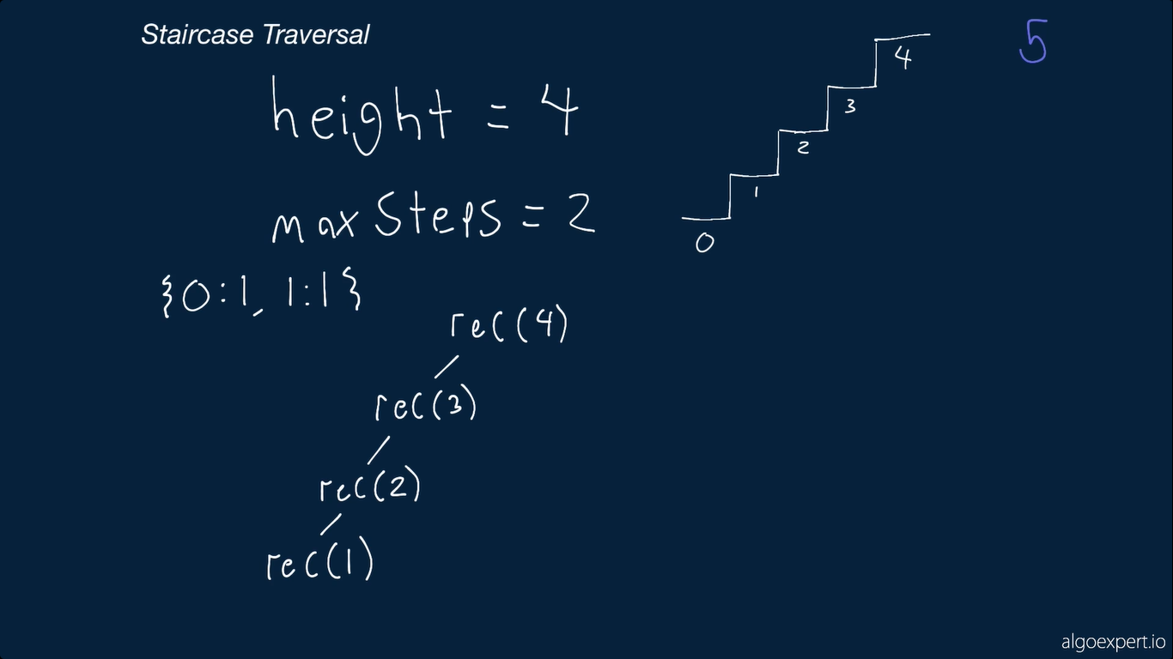

Slide 17
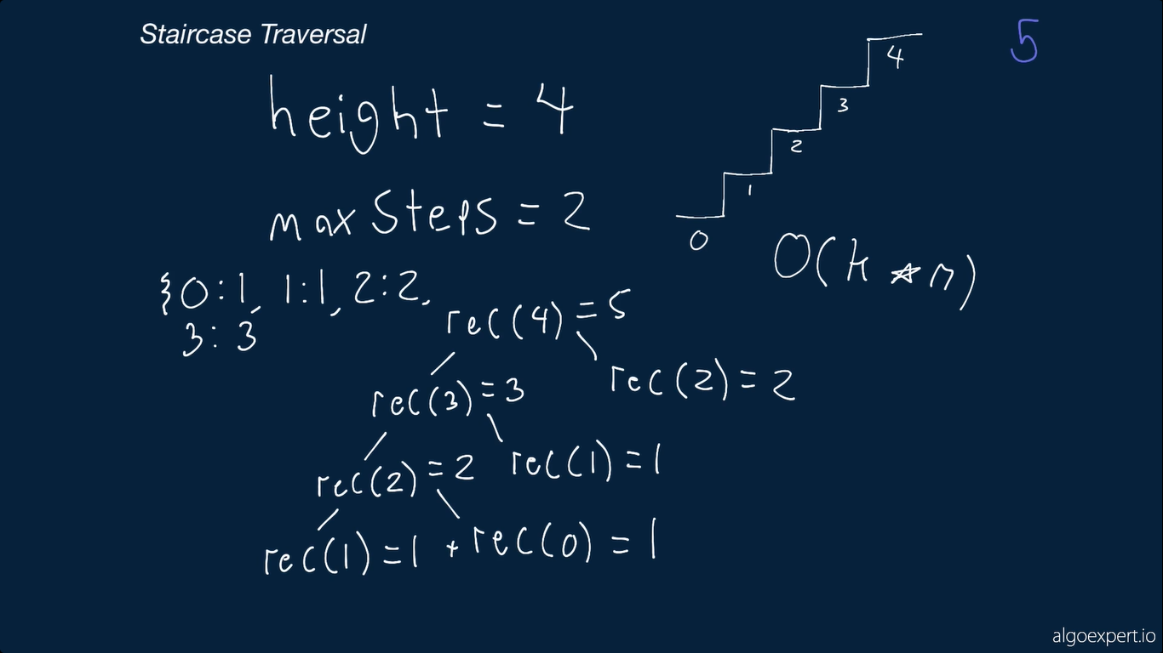

Slide 18
Solution 3
(Iterative Solution)
# O(n * k) time | O(n) space - where n is the height of the staircase and k is the number of allowed steps

Slide 19
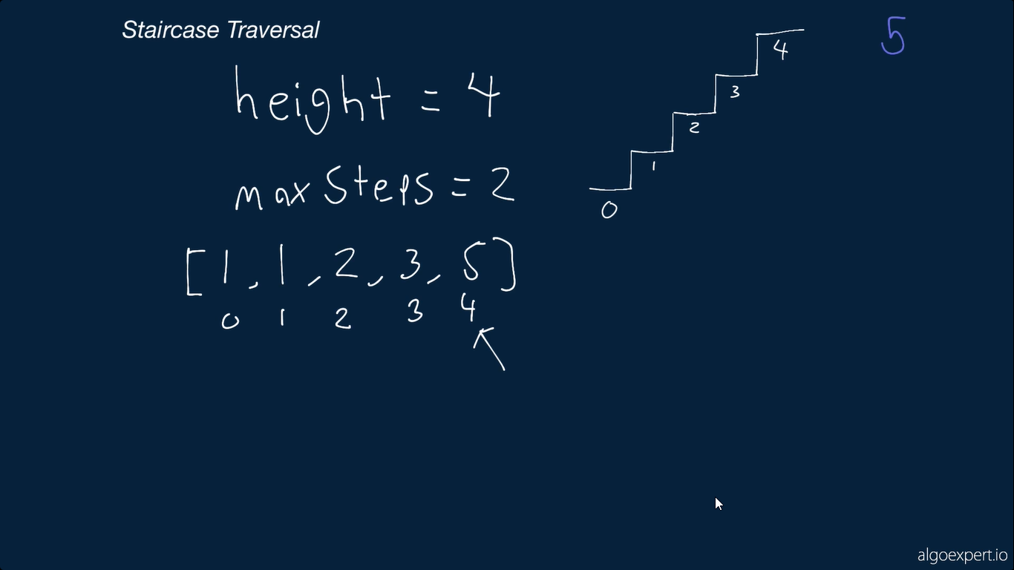

Slide 20
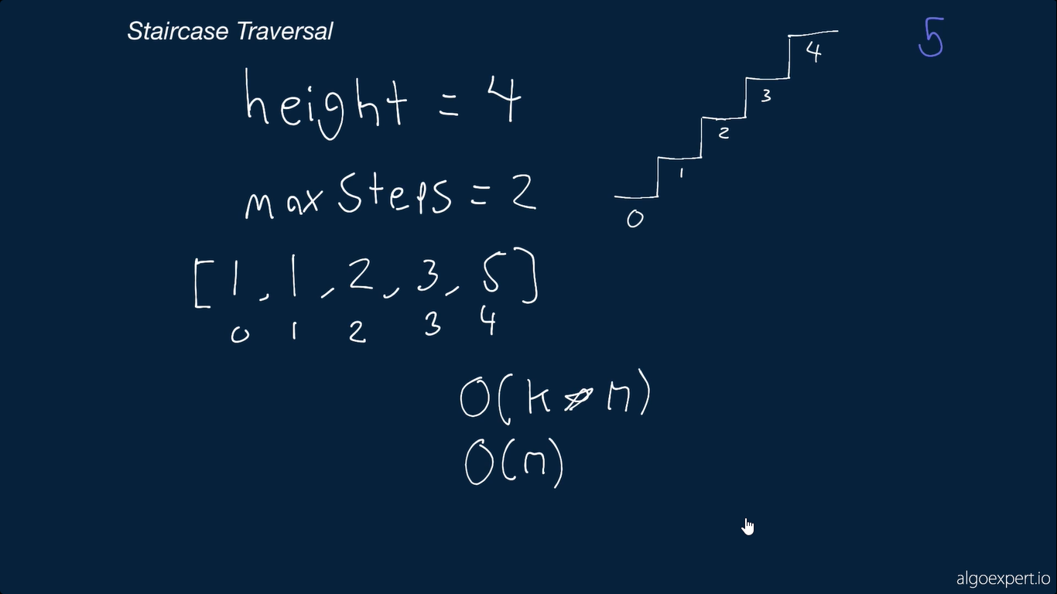

Slide 21
Solution 4
(Best time and space)
# O(n) time | O(n) space - where n is the height of the staircase

Slide 24
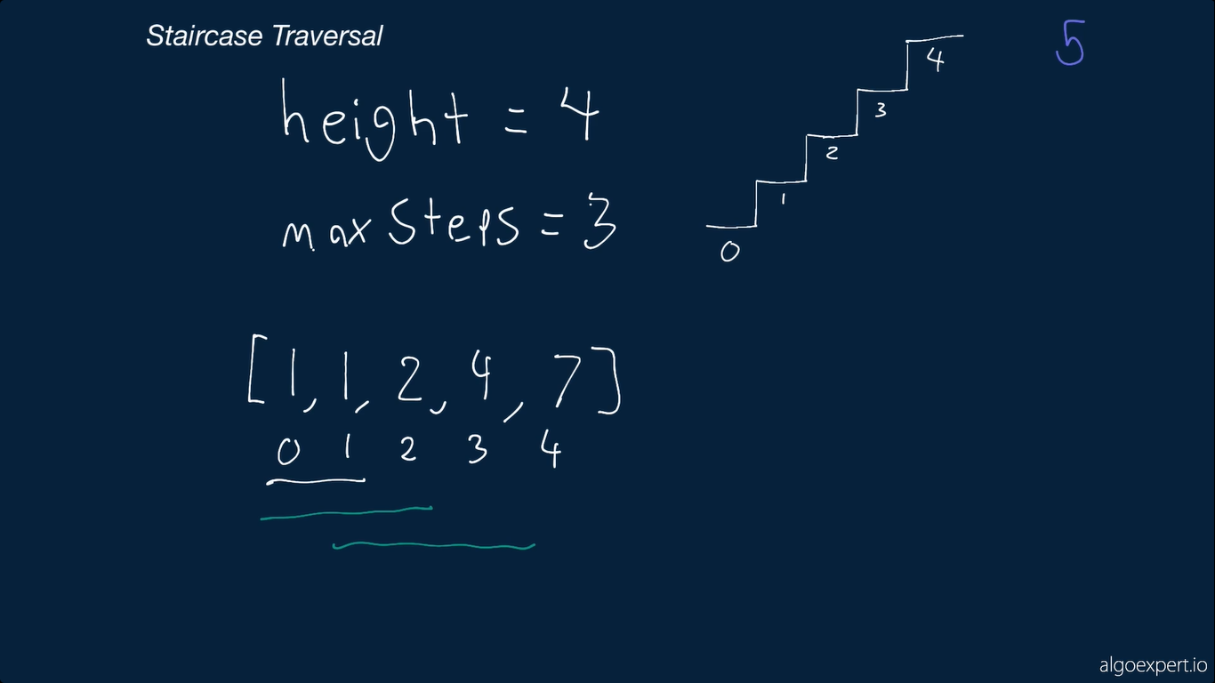

Slide 25
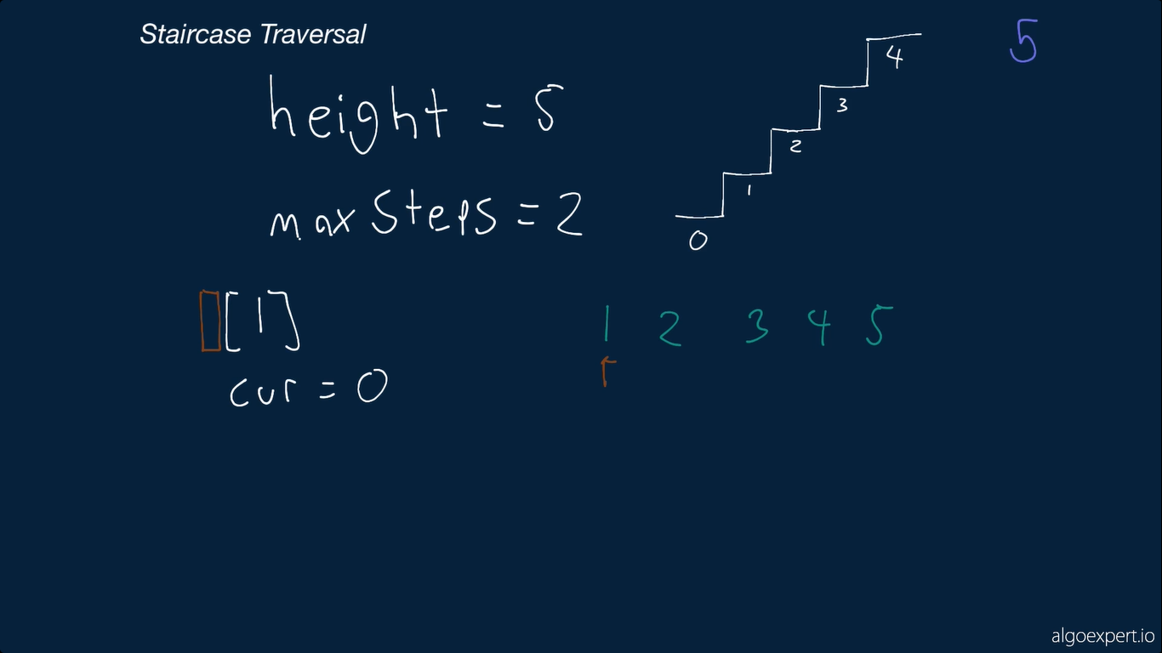

Slide 26
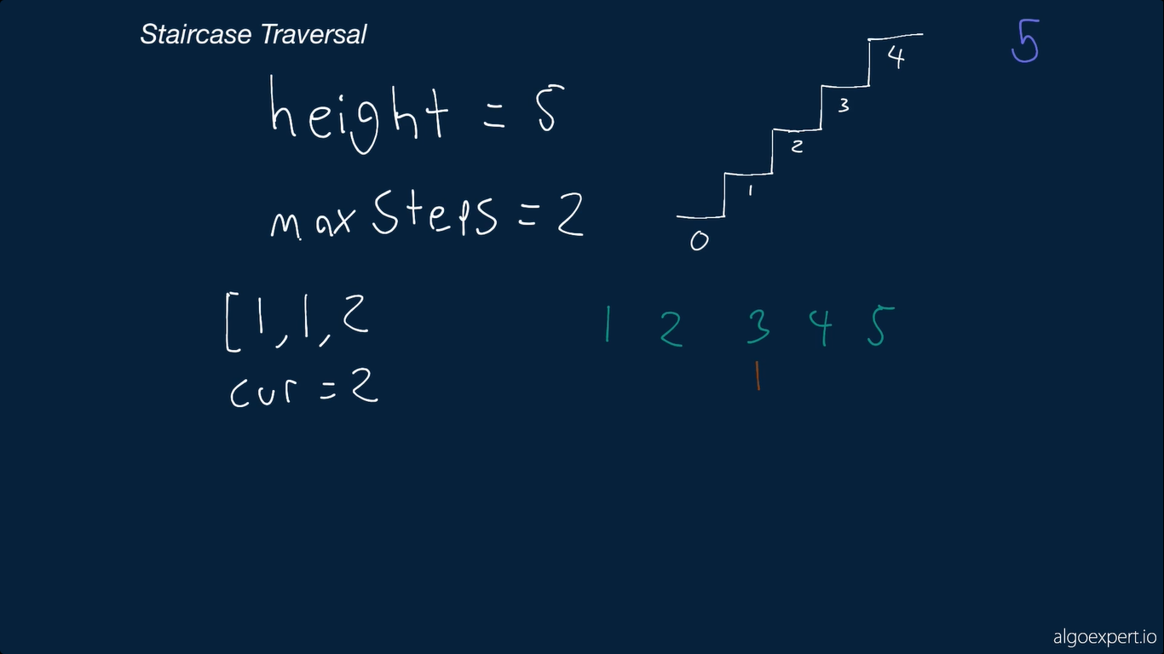

Slide 27
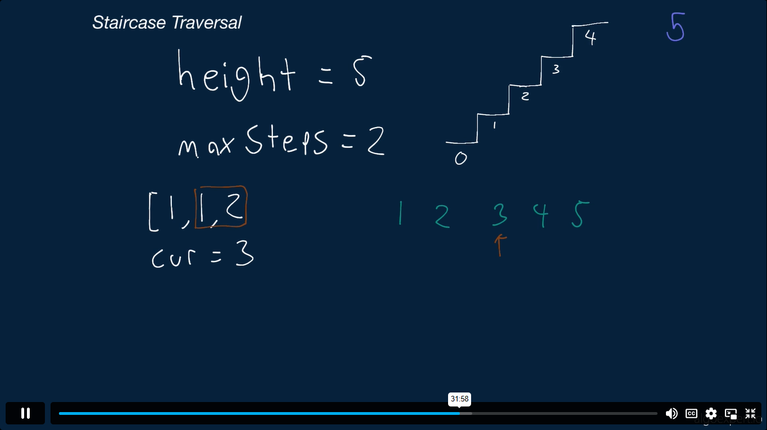

Slide 28
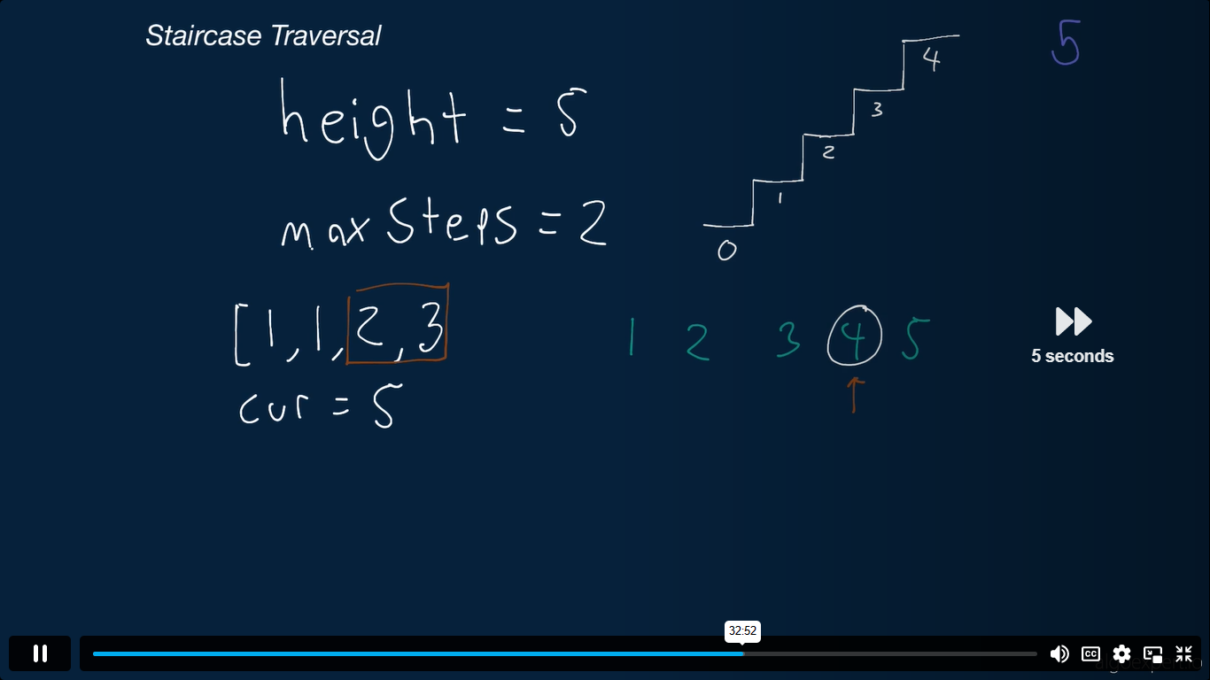

Slide 29
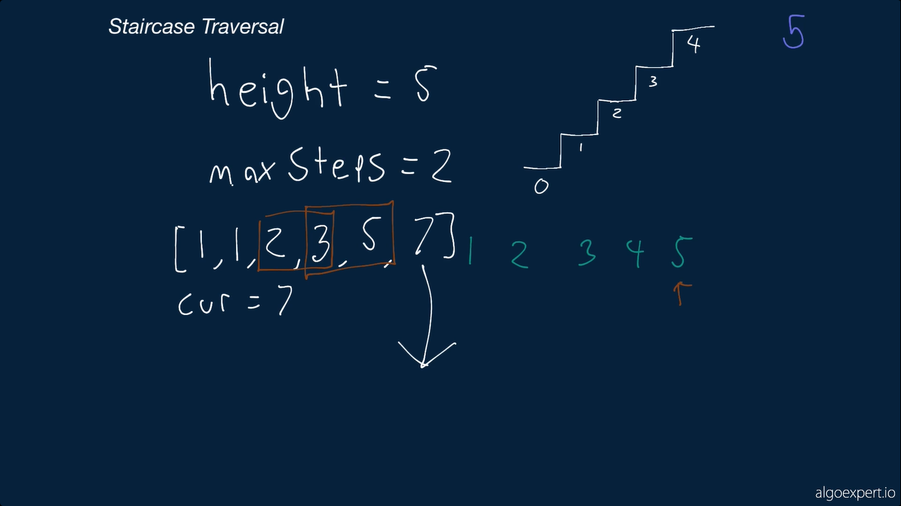

Slide 30
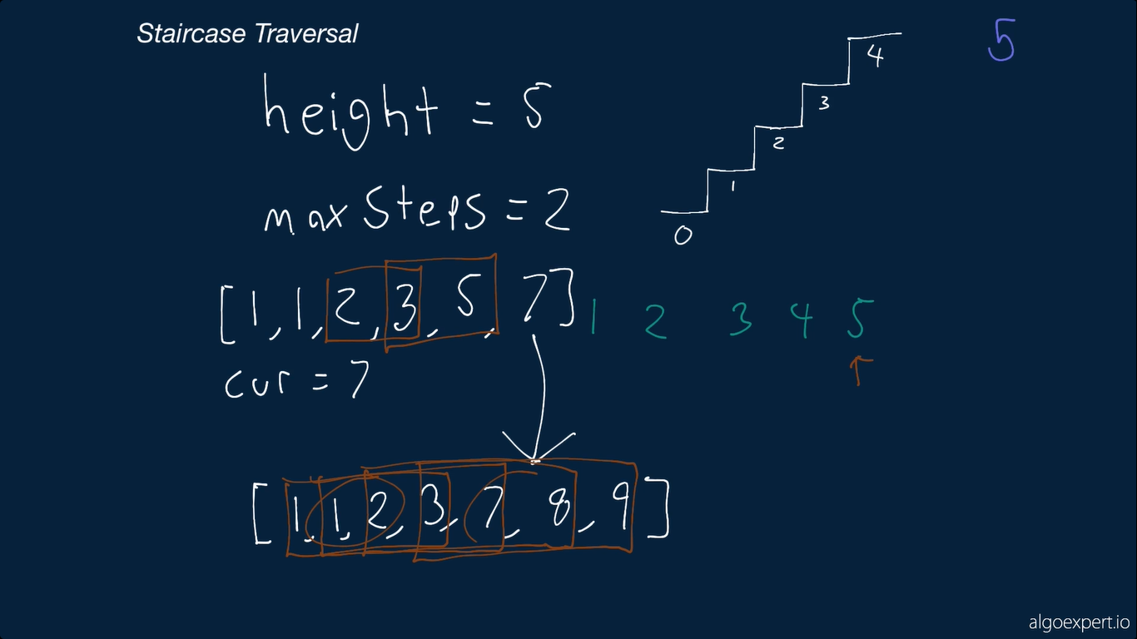

Slide 31
